Slide 1
METAMATERIAL SURFACES
Engineering light
beyond what nature did first.
From the iridescent blue of a butterfly wing to flat lenses thinner than a wavelength — how we are learning to control light at the nanoscale.
A guided tour for the optics-curious
Prepared for our guest
18 slides

Slide 2



01 / DEFINITION
What is a metamaterial?
Materials whose optical behavior comes from how they're shaped, not what they're made of.
Structure, not chemistry
Two flavors
3D metamaterial
A metamaterial is built from sub-wavelength building blocks — meta-atoms — packed in a precise pattern. Each block is far smaller than the wavelength of light, so the wave can't see them individually. It just feels an averaged effective response: permittivity ε, permeability μ, refractive index n.
Bulk, volumetric — strongest exotic effects (e.g. negative index) but lossy and hard to fabricate.
2D metasurface
Thinner than the wavelength — lower loss, easier to make, integrates into chips. The ones reshaping optics today.
Same atoms, new optics — by changing the pattern, the same silicon can act like a lens, a mirror, an absorber, or a hologram.
Metamaterial Surfaces • 2 / 18

Slide 3



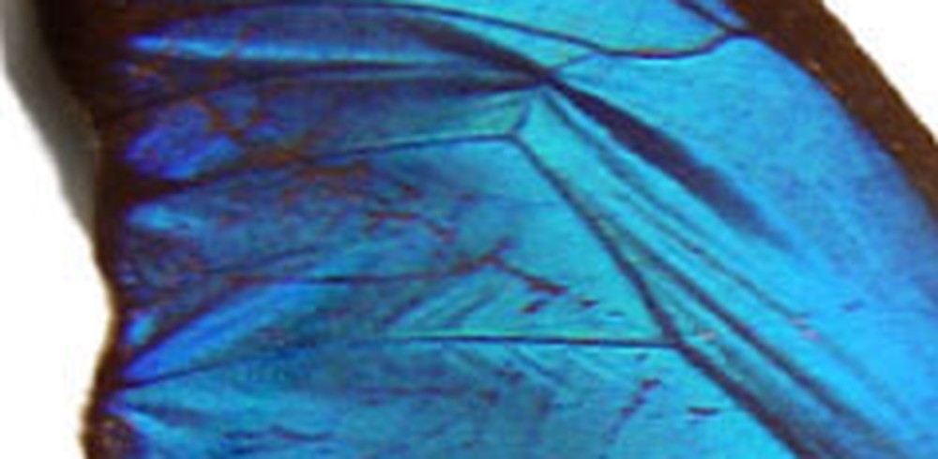
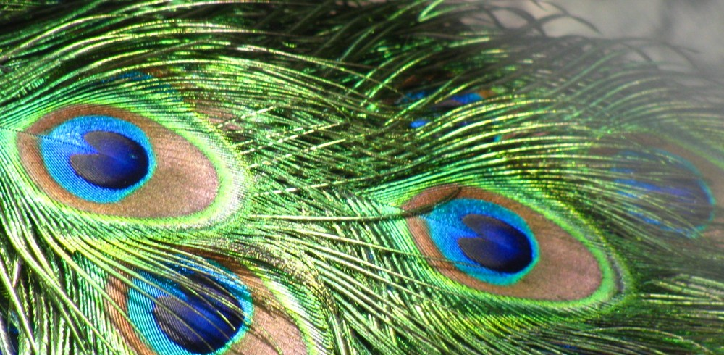
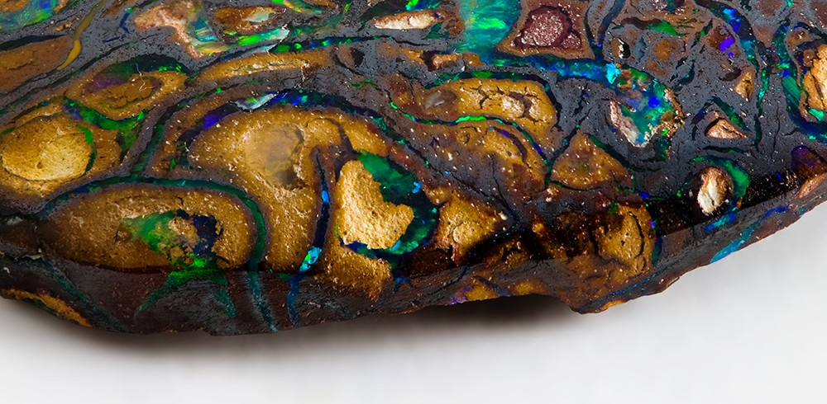
02 / STRUCTURAL COLOR
Nature got there first
Many of the world's most vivid colors aren't pigments — they're nano-architecture.
Morpho butterfly
Peacock feather
Opal
thin-film interference
2D photonic crystal
3D photonic crystal
Tree-like ridges on each scale (~200 nm spacing) act as a tiny stack of reflectors. Blue waves combine constructively; the rest cancel. Result: brilliant iridescent blue from a brown-pigmented wing.
Rods of melanin (~120 nm Ø) sit in a perfectly periodic lattice inside keratin. The lattice picks one wavelength to scatter strongly — green, blue, gold — depending on its spacing.
Stacks of silica spheres (150–300 nm Ø) close-packed like billiard balls. Bragg diffraction off the lattice planes paints the play-of-color you see when the stone is tilted.
Length scale of the magic: 100–300 nm — about 1/2000th the width of a human hair.
Metamaterial Surfaces • 3 / 18

Slide 4
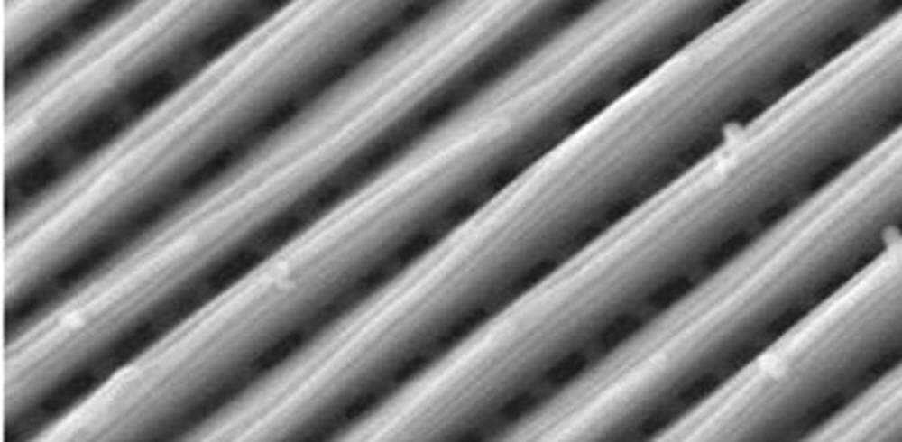
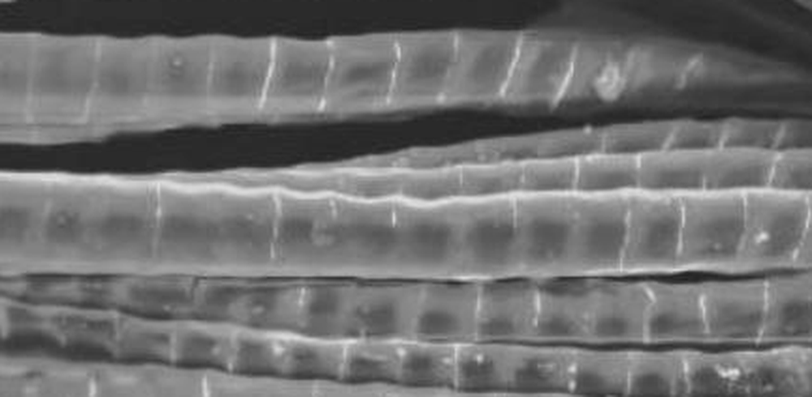
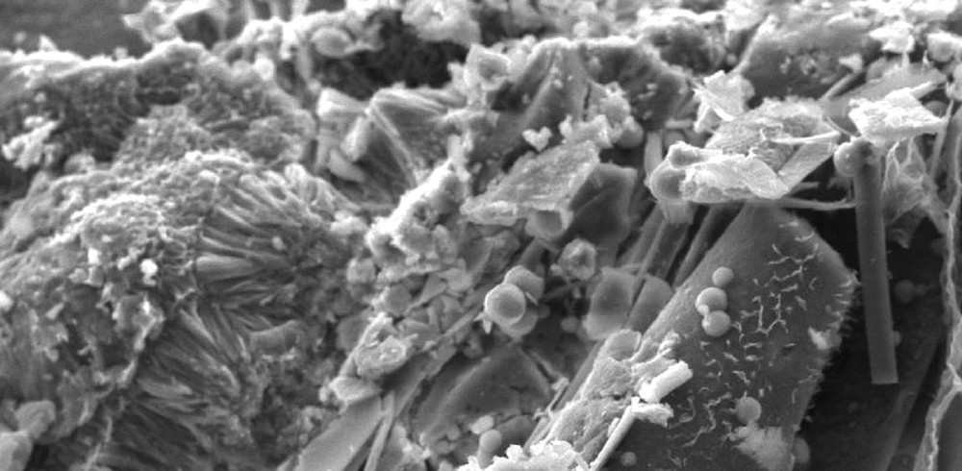
02 / THE NANOSTRUCTURE
The same colour, magnified
The very structures from the previous slide — now under the electron microscope.
Morpho butterfly
Peacock feather
Opal
chitin–air multilayer
melanin-rod barbules
~250 nm silica spheres
SEM of a Morpho cypris wing: parallel cuticle ridges form a multilayer (~510 nm chitin, ~120 nm air) that reflects intense blue.
SEM of Pavo cristatus barbules: each ridged segment packs a 2-D lattice of melanin rods (~140 nm spacing) that sets the colour.
SEM of precious opal: sub-micron silica spheres packed in a lattice that Bragg-diffracts visible light into flashes of colour.
SEM: Morpho cypris — Barrera-Patiño et al. 2020 (CC BY 4.0); Pavo cristatus — Oberholtzer & Dushkina 2024
Metamaterial Surfaces • 4 / 18

Slide 5
03 / META-ATOMS
From nature to engineering
Nature stumbled on these patterns through evolution. We design them on purpose.
The meta-atom — a tiny optical pixel
Pillar grows → phase grows
Each unit cell is a nanostructure (50–500 nm) that scatters light in a chosen way. By tuning its
size, shape, orientation, and spacing
we independently encode three knobs of the wave:
PHASE
AMPLITUDE
POLARIZATION
0 → 2π delay
scatter strength
rotate / convert
∂φ / ∂x
Metamaterial Surfaces • 5 / 18

Slide 6
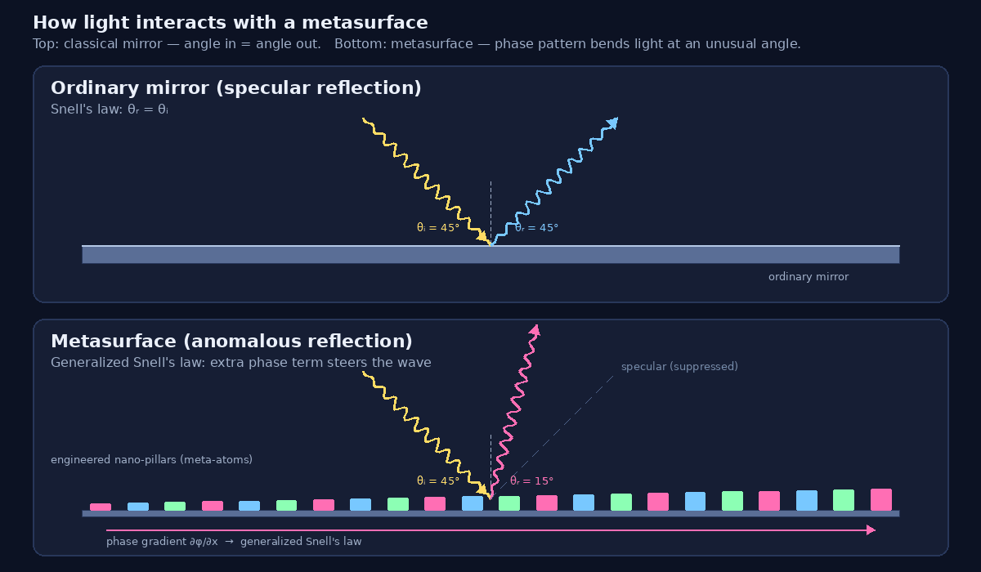
04 / GENERALIZED SNELL'S LAW
How light bends on a metasurface
A phase pattern across the surface acts like a hidden push — light reflects at angles that classical optics says are forbidden.
The equation
n₂ sin θᵣ − n₁ sin θᵢ
= (λ / 2π) · ∂φ/∂x
Take-aways
Phase gradient = extra momentum
Reflects beam at chosen angle
Even backward, with > 90% efficiency
Metamaterial Surfaces • 6 / 18

Slide 7

05 / BUILDING BLOCKS
Engineered nanostructures
Three families of meta-atoms power most modern metasurfaces.
Plasmonic resonators
Dielectric Mie resonators
Split-ring resonators
gold / silver nano-antennas
silicon nano-pillars / disks
the original meta-atom (2000)
Free electrons in tiny metal particles oscillate with the light wave (LSPR). Sharp tips create field hot-spots up to 10³× stronger than incident light — useful for sensing, but with optical loss.
High-index silicon supports both electric and magnetic dipole modes. Almost lossless, so resonances stay sharp. Today's metalenses and most biosensors are built from these.
Two C-shaped metal rings with a tiny gap form an LC circuit at GHz–THz. First demonstrated negative refractive index. Mostly used at microwave/THz today; foundational for the field.
Q ≈ 10–50 • visible / NIR
Q up to 10⁴ • broadband phase control
GHz – THz • proof of negative index
Made by electron-beam lithography, nanoimprint, or self-assembly — and increasingly on standard CMOS lines.
Metamaterial Surfaces • 7 / 18

Slide 8
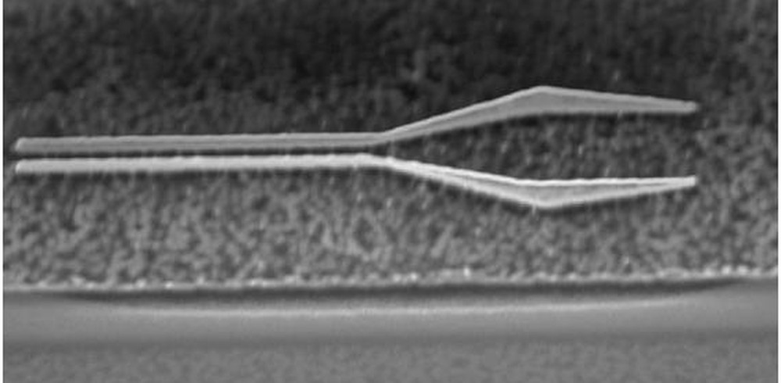
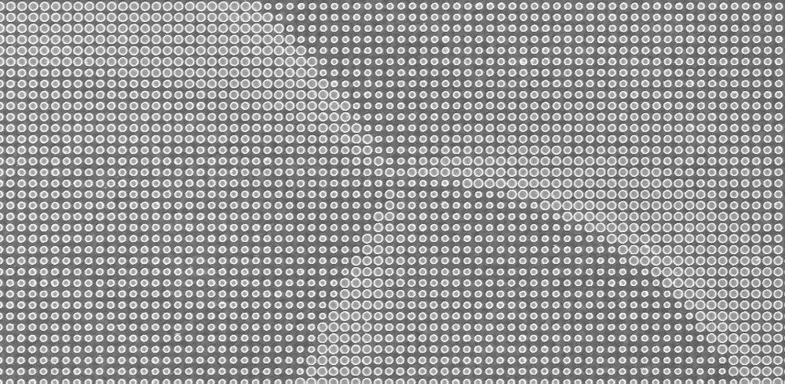
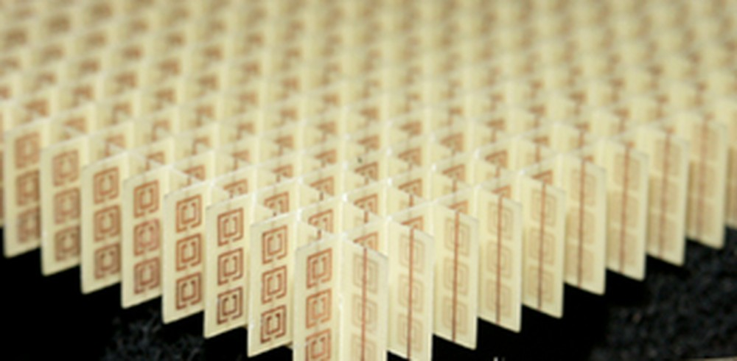
05 / FABRICATED META-ATOMS
Engineered, and imaged
The three meta-atom families from the previous slide — as real fabricated structures.
Plasmonic
Dielectric
Split-ring
gold nano-antennas
silicon nanopillars
C-shaped resonators
FIB-milled gold antennas. Free electrons resonate with light, concentrating the field into nanometre hot-spots — strong, but lossy.
SEM of a silicon metasurface: thousands of sub-wavelength pillars, each tuned in size to imprint a chosen phase. Almost lossless.
An array of split-ring resonators — tiny LC circuits that first demonstrated a negative refractive index at microwave frequencies.
Made by electron-beam lithography, focused-ion-beam milling, and increasingly on standard CMOS lines.
Metamaterial Surfaces • 8 / 18

Slide 9
05 / CHOOSING A META-ATOM
Which meta-atom, and why
Three ways to build the same trick — each with a different strength.
Plasmonic
Dielectric
Split-ring
gold nano-antennas
silicon nanopillars
C-shaped resonators
✓ Field hot-spots ~10³× → single-molecule SERS
× Ohmic loss turns light into heat
→ Best for: ultra-sensitive biosensors
✓ Near-lossless, high-Q, made on CMOS lines
× Weaker local field than metal
→ Best for: metalenses & today’s biosensors
✓ First negative index — impossible in nature
× Hard to shrink to visible light
→ Best for: microwave / THz, cloaking
All three beat bulk 3-D metamaterials — far thinner, lower-loss, and integrable straight onto a chip.
Metamaterial Surfaces • 9 / 18

Slide 10




06 / APPLICATIONS
Where metasurfaces are showing up
From cameras to LiDAR to paint — flat optics are leaving the lab.
Flat metalenses
Holograms & AR/VR
A glass plate one wavelength thick replacing curved camera optics. Capasso's 100-mm visible metalens (2024) focuses 430–780 nm with no chromatic aberration.
Phase patterns encode entire 3D scenes. Field-of-view > 45°, full-color, aberration-corrected — a path to real holographic displays.
Solid-state LiDAR
Structural-color paint
Electronically steered phased-array metasurfaces — no spinning mirrors. Lumotive, Analog Photonics, others targeting autonomous vehicles.
Plasmonic 'paint' at ~0.4 g/m² — about 100× lighter than pigment paint, never fades because the color is the geometry.
Metamaterial Surfaces • 10 / 18

Slide 11
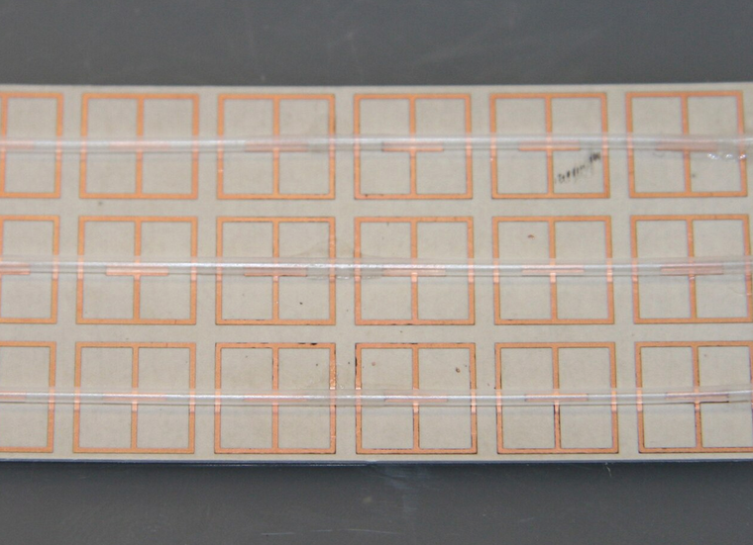
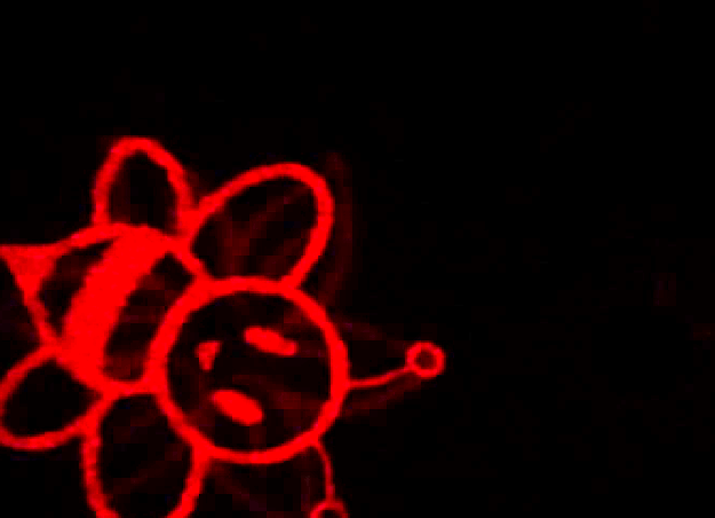
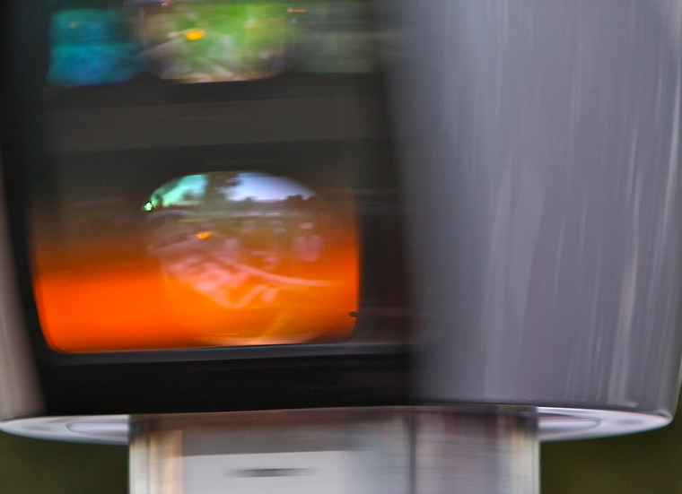
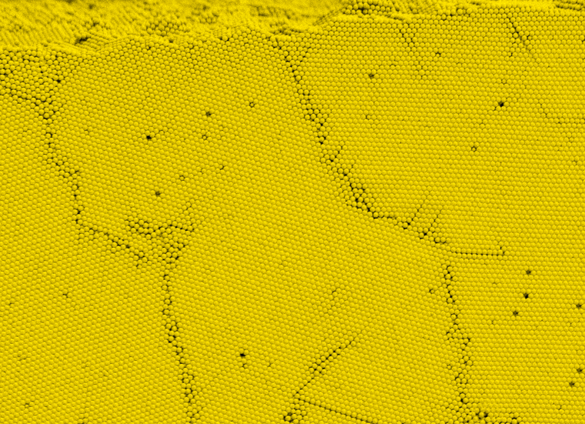
06 / APPLICATIONS
Flat optics, out in the world
The same toolkit, now shipping in cameras, displays, sensors and surfaces.
Flat metalenses
Holograms & AR/VR
A wavelength-thin metasurface replaces curved camera optics — focusing light with no bulky glass.
Phase patterns rebuild full 3-D scenes. This is a real image projected by a metasurface hologram.
Solid-state LiDAR
Structural-colour paint
Beam-steering metasurfaces replace spinning mirrors — compact depth sensing for self-driving cars.
Colour from geometry, not pigment — lightweight, and it never fades because the structure cannot.
Metamaterial Surfaces • 11 / 18

Slide 12
06 / THE PAYOFF
Flat optics vs the old way
For each application, what a metasurface replaces — and why it wins.
Flat metalenses
✓ One flat element thinner than a hair — lighter cameras & endoscopes; achromatic designs end colour-fringing.
Replaces a stack of curved glass
Holograms & AR/VR
✓ Full-colour, wide field of view, no moving parts — compact AR/VR and un-clonable security tags.
Replaces bulky SLMs & projector optics
Solid-state LiDAR
✓ No moving parts: cheaper, rugged, chip-scale, faster beam-steering — for self-driving cars & robotics.
Replaces spinning mechanical LiDAR
Structural colour
✓ Never fades, ~100× lighter, non-toxic — durable coatings, and colour that doubles as a sensor.
Replaces pigments & dyes
Metamaterial Surfaces • 12 / 18

Slide 13
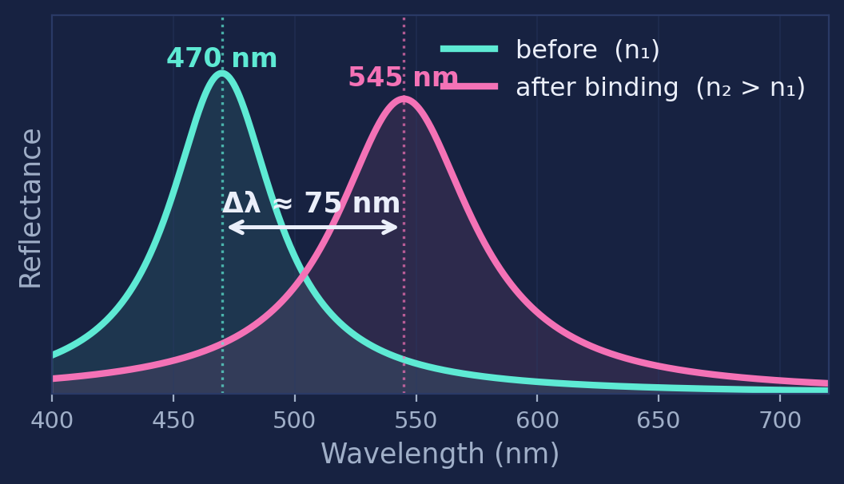
07 / READING THE SHIFT
1-D gratings: the peak that moves
How a periodic stack turns a tiny refractive-index change into a colour shift you can measure.
λpeak = 2 neff d
grating / Bragg reflection
1
A 1-D grating reflects a single peak wavelength, fixed by the spacing d and the effective index n_eff.
2
Bind a molecule and n_eff rises — the whole peak red-shifts by Δλ.
3
Measure Δλ and the grating becomes a label-free sensor — the basis of the biosensors ahead.
Real example: ZnO-loaded peacock barbules shifted 470 → 545 nm (Bayan et al. 2011).
Metamaterial Surfaces • 13 / 18

Slide 14
07 / BIOMEDICAL — THE PRINCIPLE
Sensing molecules with light
When a biomarker lands on a metasurface, the resonance shifts color. The shift is the signal.
Refractive-index sensing
Figures of merit
Pillars create a strong evanescent field above the surface. Anything that lands changes the local refractive index, which shifts the resonance wavelength.
Sensitivity
100 – 2 256
nm / RIU
Quality factor (Q)
10 – 10 000+
sharper = stronger
Limit of detection
femto-molar
biomarker bound → Δn → Δλ
single-molecule scale
Metamaterial Surfaces • 14 / 18

Slide 15



08 / EARLY DETECTION
Catching cancer earlier
Metasurface biosensors detect tumor markers at concentrations far below what blood tests can see today.
40 000×
more sensitive than ELISA.
A nanogap metasurface PSA sensor reaches ~40 fM — about 25 prostate-cancer marker molecules in 1 mL of serum.
Circulating tumor DNA
Tumor exosomes
Tissue THz fingerprint
Mutations in cell-free DNA appear weeks-to-months before a tumor is visible on imaging. Plasmonic + dielectric metasurfaces enable label-free, real-time detection.
30–150 nm vesicles shed by cancer cells, carrying RNA and proteins. Magnetoplasmonic metasurfaces have demonstrated ultrasensitive detection from blood and saliva.
Cancer tissue absorbs terahertz waves differently than healthy tissue. Microfluidic THz metamaterial chips discriminate cervical, breast, lung, and liver cancer cells.
Metamaterial Surfaces • 15 / 18

Slide 16
09 / METASURFACE vs ELISA
Why this beats the standard test
Side-by-side, on the practical numbers that matter for early screening.
Metric
Conventional ELISA
Metasurface biosensor
Sensitivity
~ 1 pM (picomolar)
~ 40 fM (femtomolar)
Sample volume
100 – 500 µL
fL – pL droplets
Time to result
hours, multi-step
minutes, single chip
Labels needed
enzyme conjugates, dyes
label-free
Multiplexing
1 marker per well
5 – 10 markers in parallel
Real-time kinetics
no — endpoint only
yes — binding live
The combination — ultra-low LOD, label-free, multiplexed, fast — is exactly what early-stage cancer screening needs.
Metamaterial Surfaces • 16 / 18

Slide 17


10 / RECAP
The story in one picture
From an opal to an early-detection chip — same physics, different goals.
01
02
03
04
Sub-λ pattern
Effective optics
Anomalous behavior
Useful device
Build something smaller than the wavelength of light.
The wave sees an averaged response you can design.
Bend, focus, absorb, or split light any way you want.
Flat lenses, holograms, paint, LiDAR — and cancer biosensors.
Same toolkit. The next slide is what you do with it.
Metamaterial Surfaces • 17 / 18

Slide 18
THANK YOU
Light, redesigned —
and tuned to listen for the earliest whispers of disease.
STRUCTURE
INSPIRATION
IMPACT
Geometry, not chemistry, is the new control knob in optics.
Butterflies, peacocks, and opals showed what's possible — at room temperature.
Femtomolar biosensors put cancer detection within reach of a flat chip.
feisal kroushawi • Metamaterial sensors for early cancer detection

